Slide 1

Introduction to Insurance Claim Fraud Detection
Insurance claim fraud detection involves using deep learning algorithms to analyze patterns and anomalies in claim data.
By leveraging advanced techniques, insurers can identify suspicious claims and mitigate potential losses.
Presented by
SURENDAR A
KVCET/CSE –III Year
NM ID: au421221104-45
Email ID: surendar2003721@gmail.com

Slide 2


Understanding the Challenges of Fraud Detection in Insurance Claims
Fraud detection in insurance claims presents significant challenges due to the complex nature of fraudulent activities and the ability of fraudsters to adapt and evolve their techniques over time.
Insurance companies face the task of distinguishing between legitimate and fraudulent claims while ensuring a seamless and efficient claims process for genuine policyholders.

Slide 3
Traditional methods vs. Deep Learning for fraud detection
Traditional Methods
Deep Learning
Manual rules-based approaches
Automatic feature learning
Relies heavily on human expertise
Can handle unstructured data
Difficulty in handling large datasets
Adaptable to evolving fraud patterns

Slide 4
Benefits of using Deep Learning in insurance claim fraud detection
Improved Accuracy
Real-Time Detection
Deep learning models can detect complex patterns and anomalies with greater precision.
Deep learning algorithms enable swift identification of fraudulent claims, reducing financial losses.
Adaptability to New Patterns
Reduced False Positives
They can adapt to new types of fraud without needing manual updates.
Deep learning reduces the number of false alarms, saving time and resources.

Slide 5
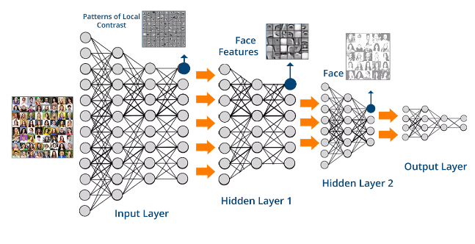
Data Requirements and Preprocessing
High-quality and diverse datasets are essential for training deep learning models in insurance claim fraud detection.
Data preprocessing involves normalization, outlier detection, and feature engineering to optimize model performance.
Proper handling of imbalanced datasets is crucial to ensure accurate and reliable fraud detection.

Slide 6


Building and Training Deep Learning Models for Fraud Detection
1
Data Collection
Gathering relevant and diverse datasets to train the deep learning models.
2
Preprocessing
Applying data cleaning, normalization, and feature engineering to prepare the data.
3
Model Architecture
Designing the neural network structure, choosing layers, and optimizing parameters.

Slide 7

Evaluating the Performance of Deep Learning Models in Fraud Detection
When evaluating the performance of deep learning models in fraud detection, it is essential to consider metrics such as precision, recall, and F1 score. Additionally, the detection of false positives and false negatives is crucial for assessing the model's effectiveness.

Slide 8

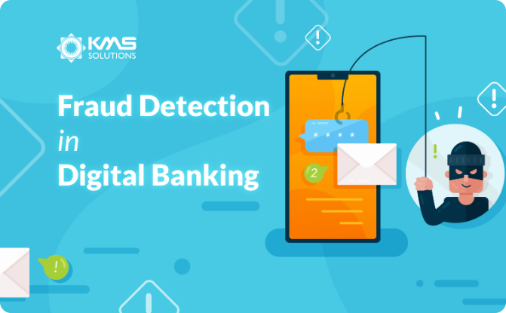
Case studies and real-world applications
Real-world Case Study
Practical Application
Explore how deep learning was used to uncover fraudulent insurance claims in a major case study.
Discover a real-world example of deep learning technology effectively combating insurance claim fraud.

Slide 9




Future trends and advancements in deep learning for insurance claim fraud detection
Unsupervised Learning
1
Discovering patterns without labeled data
Explainable AI
2
Providing transparency in model decisions
Adversarial Networks
3
Improving resilience to adversarial attacks
Automated Feature Engineering
4
Streamlining the feature extraction process

Slide 10
Conclusion and key takeaways
Importance of deep learning: Deep learning offers powerful tools for accurate fraud detection in insurance claims.
Continuous improvement: Regular model updates and data analysis are essential for staying ahead of evolving fraud techniques.
Collaboration and regulation: Collaboration between industry partners and regulatory bodies is crucial for combating fraud effectively.

